Slide 1
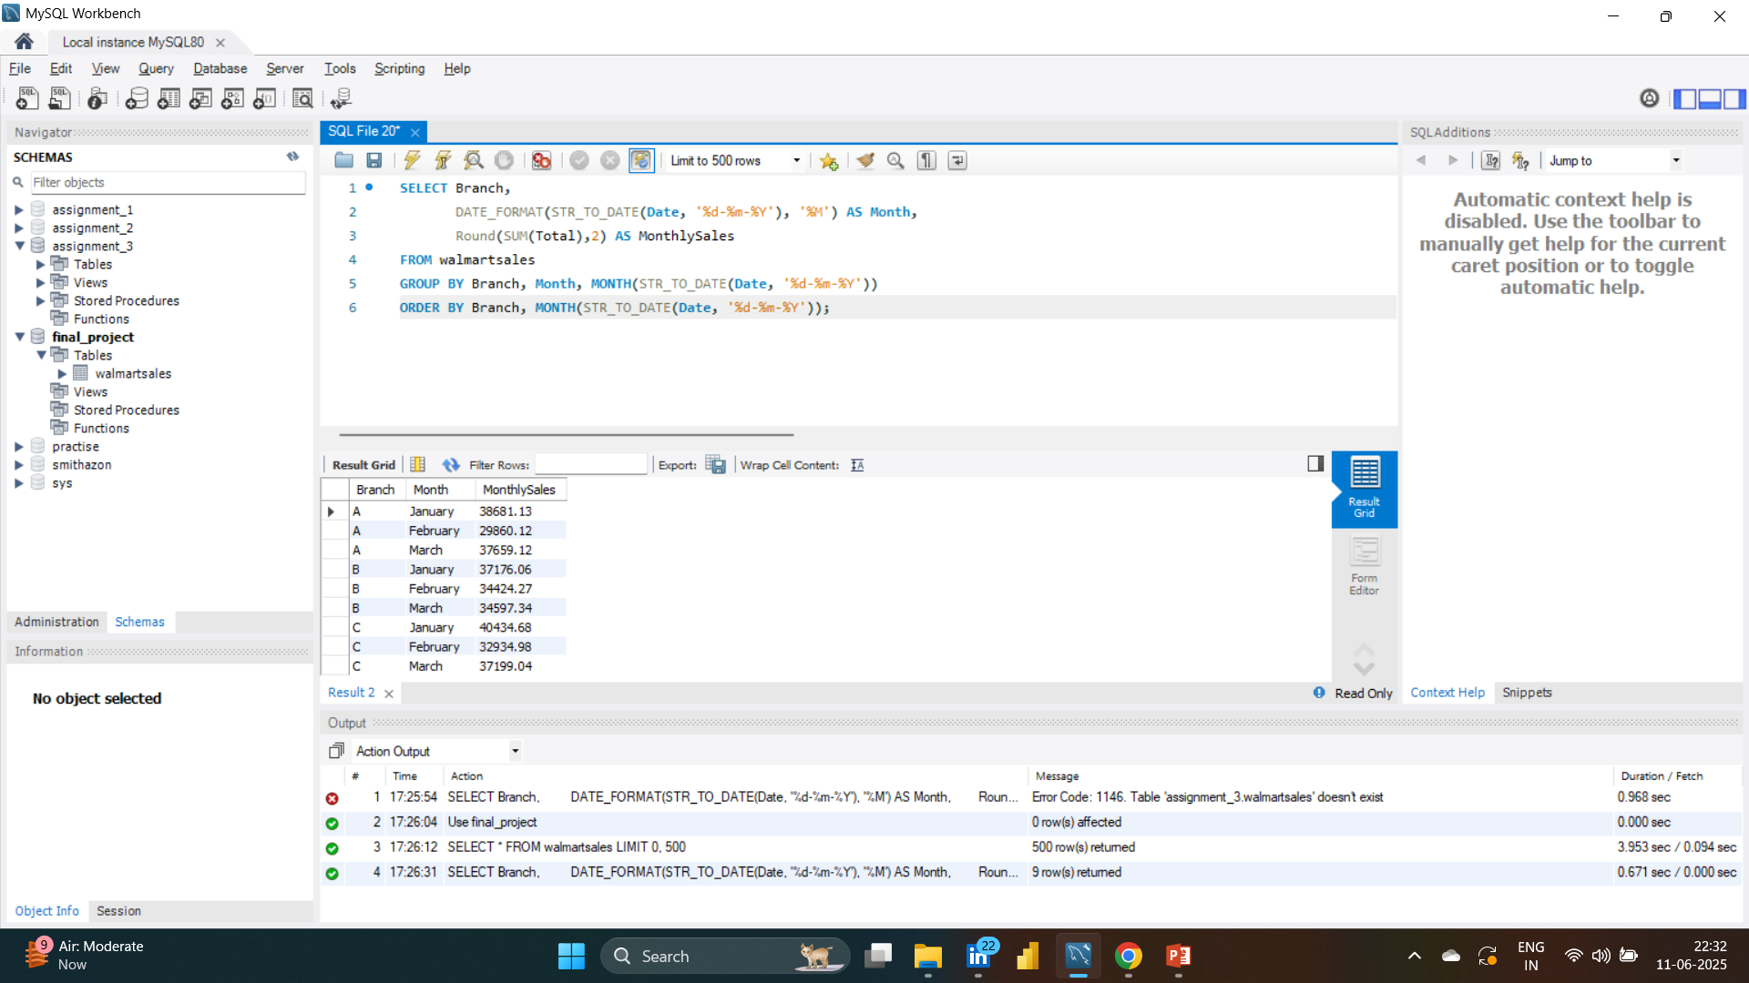
Task 1: Identifying the Top Branch by Sales Growth Rate

Slide 2
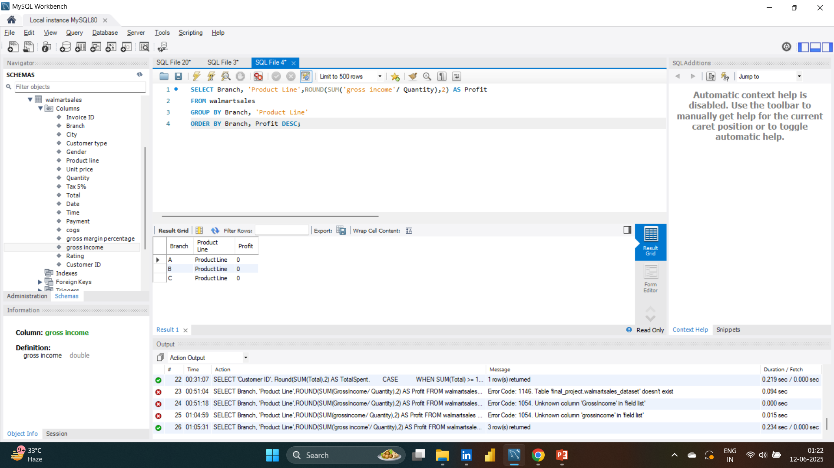
Task 2: Finding the Most Profitable Product Line for Each Branch

Slide 3
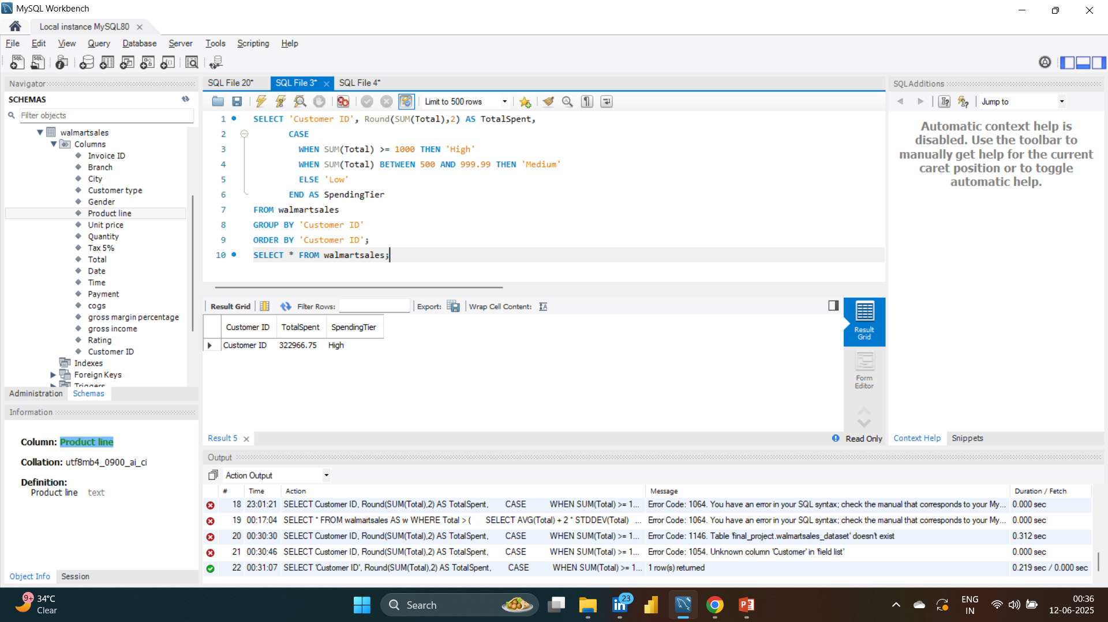
Task 3: Analyzing Customer Segmentation Based on Spending

Slide 4
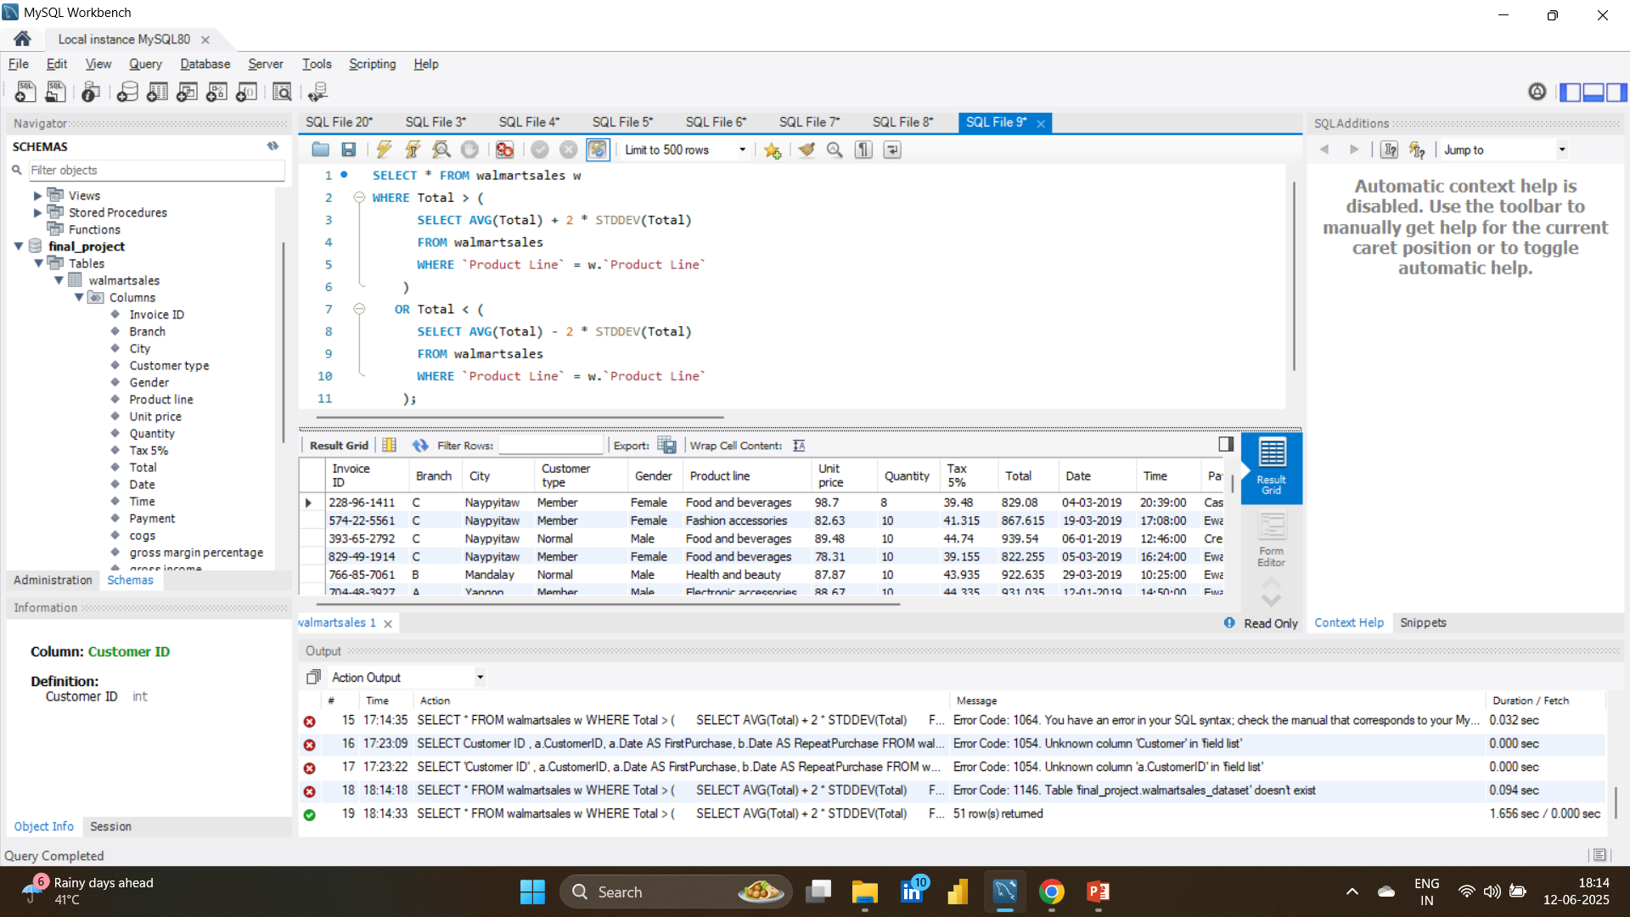
Task 4: Detecting Anomalies in Sales Transactions

Slide 5
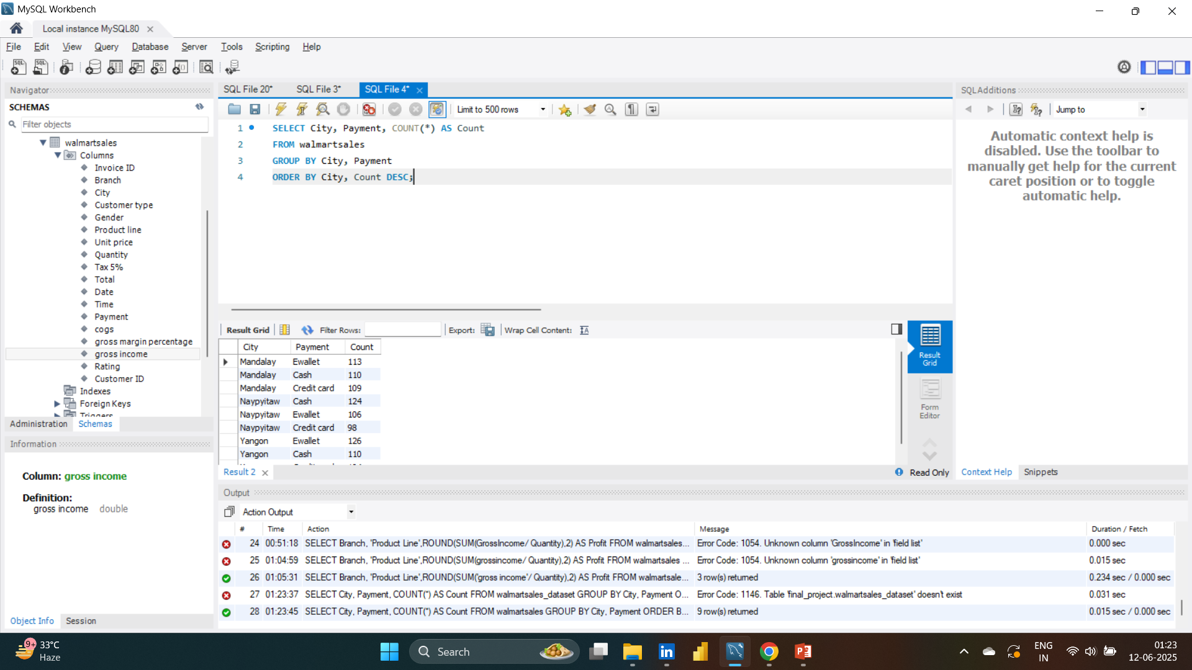
Task 5: Most Popular Payment Method by City

Slide 6
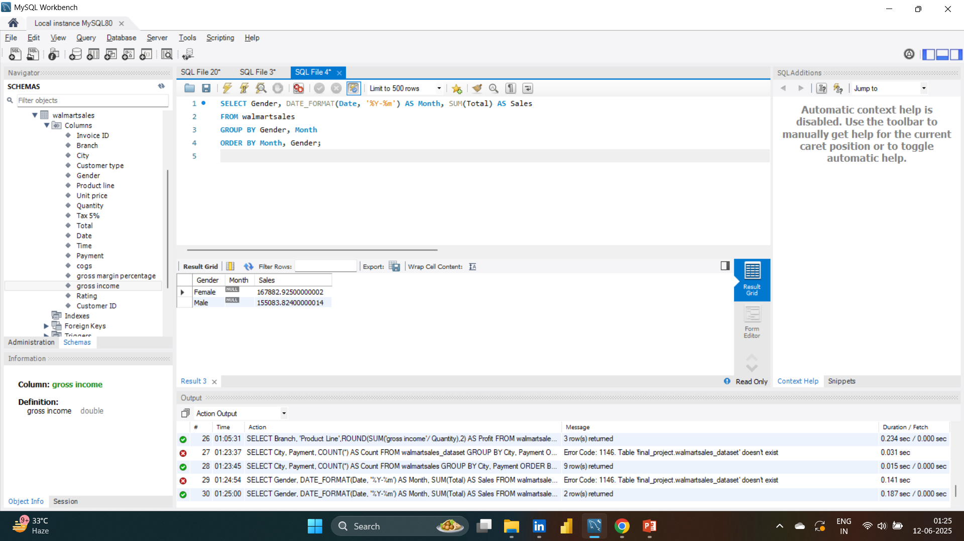
Task 6: Monthly Sales Distribution by Gender

Slide 7
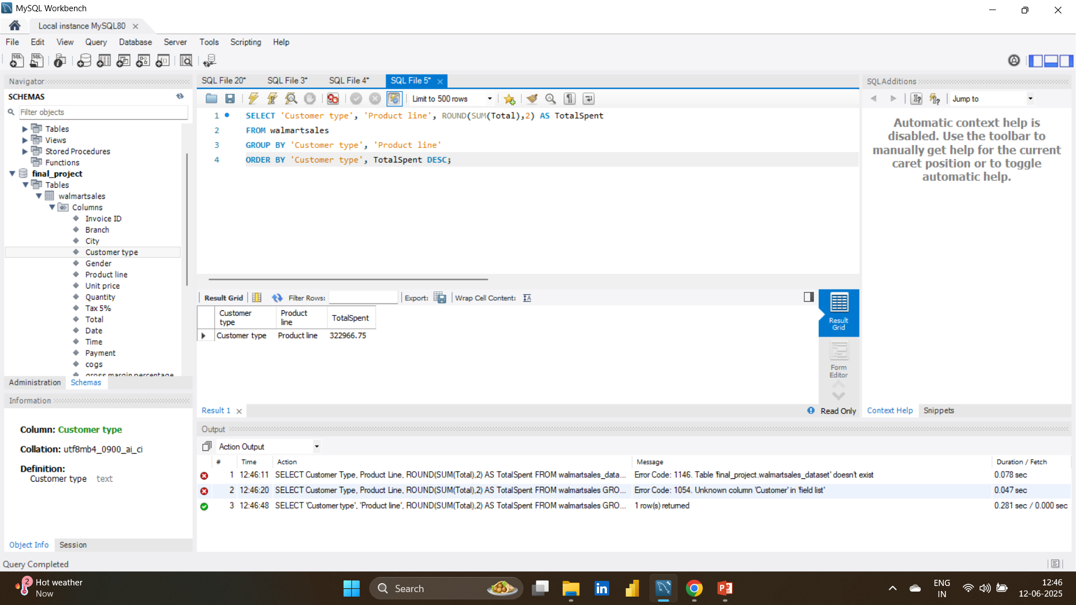
Task 7: Best Product Line by Customer Type

Slide 8
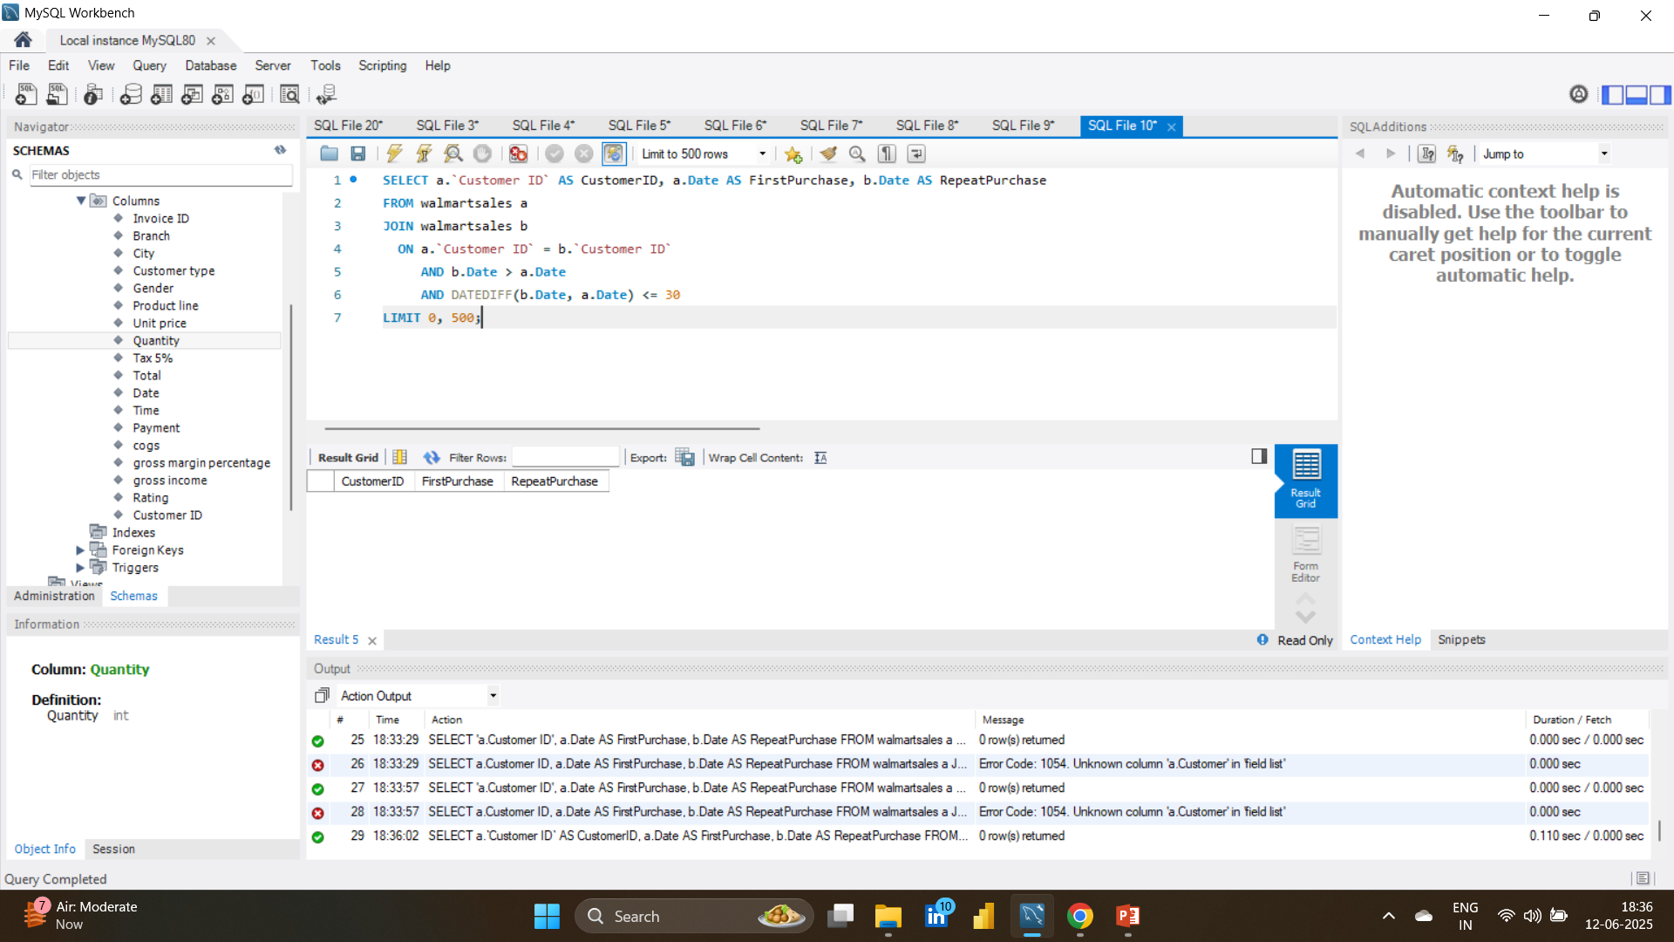
Task 8: Identifying Repeat Customers

Slide 9
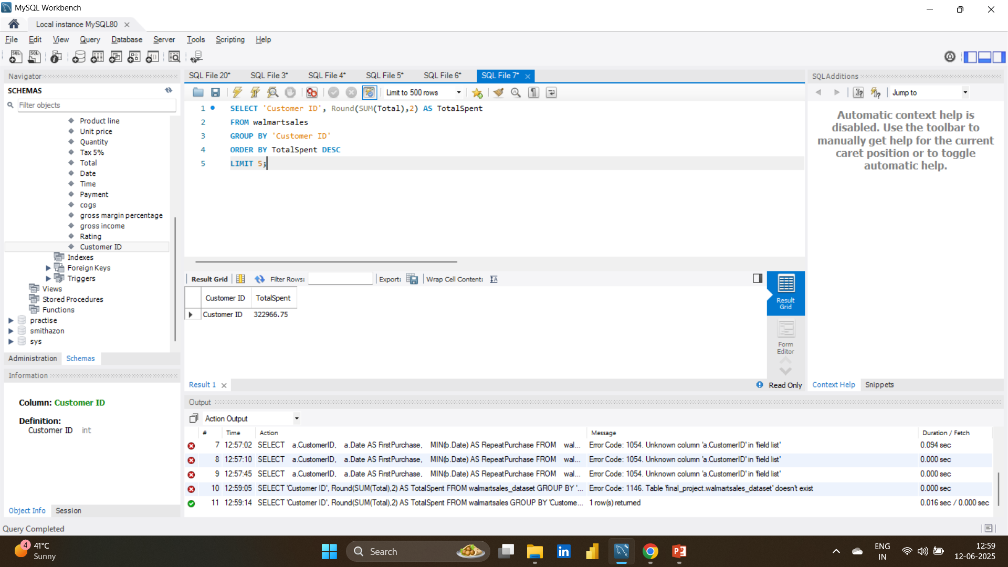
Task 9: Finding Top 5 Customers by Sales Volume

Slide 10
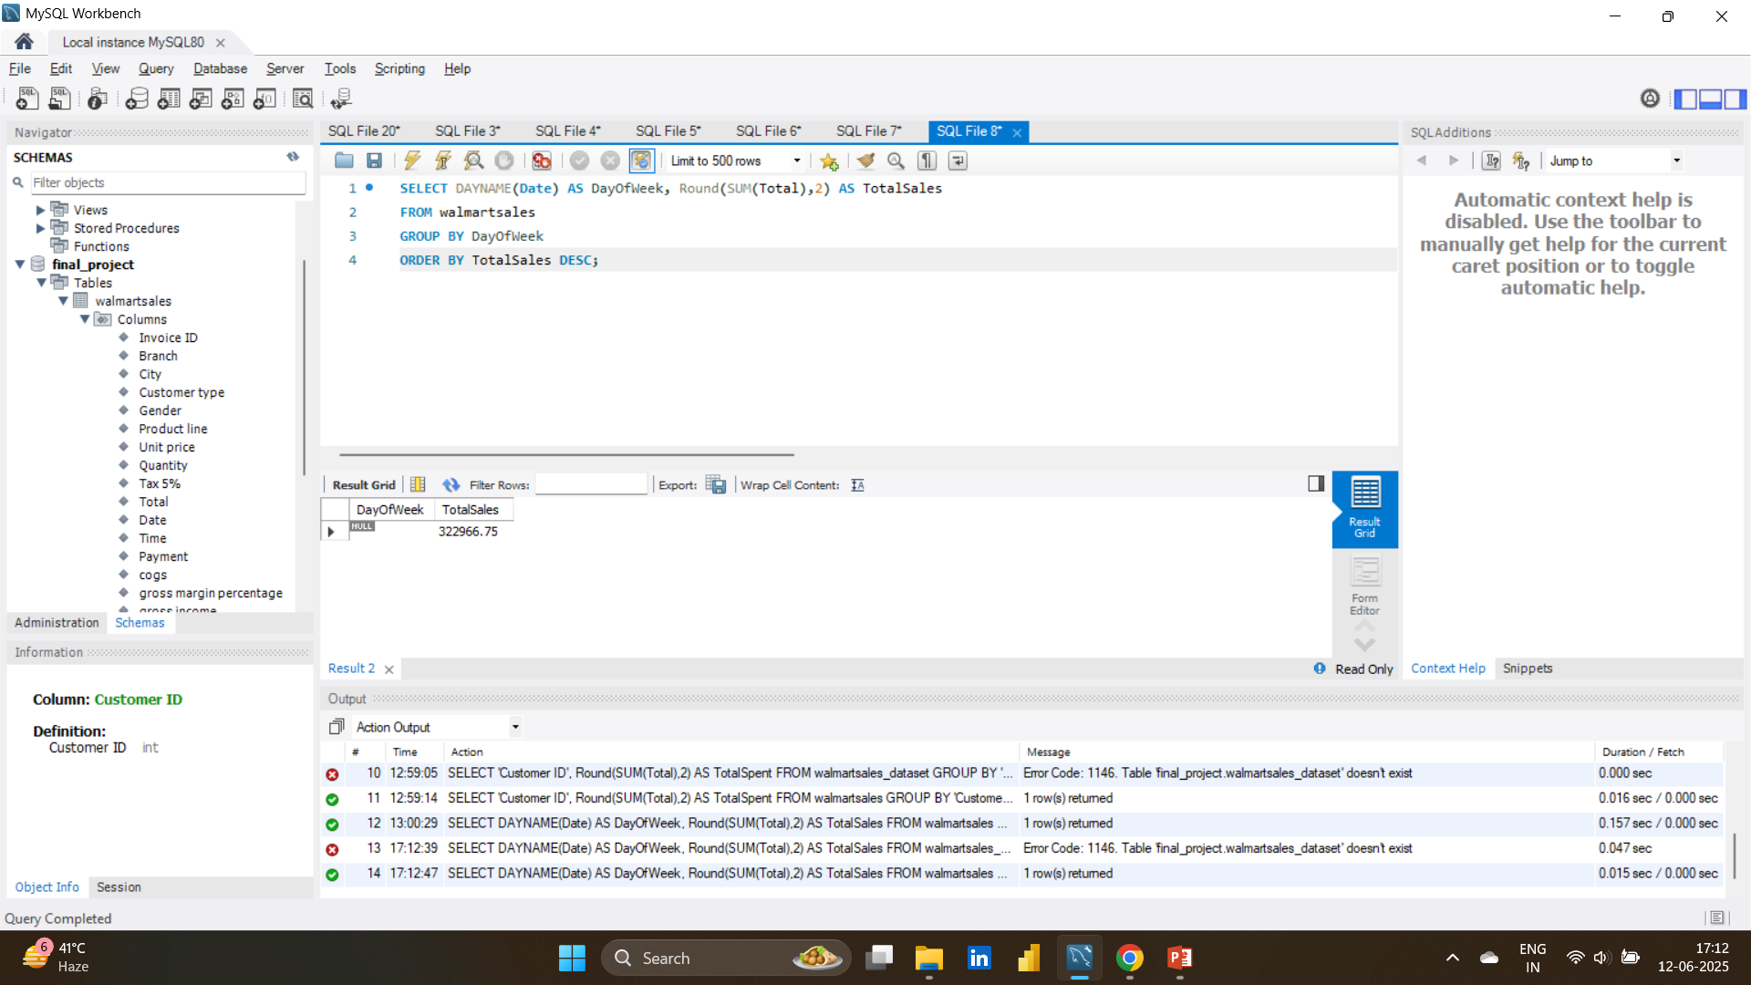
Task 10: Analyzing Sales Trends by Day of the Week

